Slide 1
Isotopes.au Team Meeting
CSIRO & ANSTO & GA & Lithodat

Slide 2
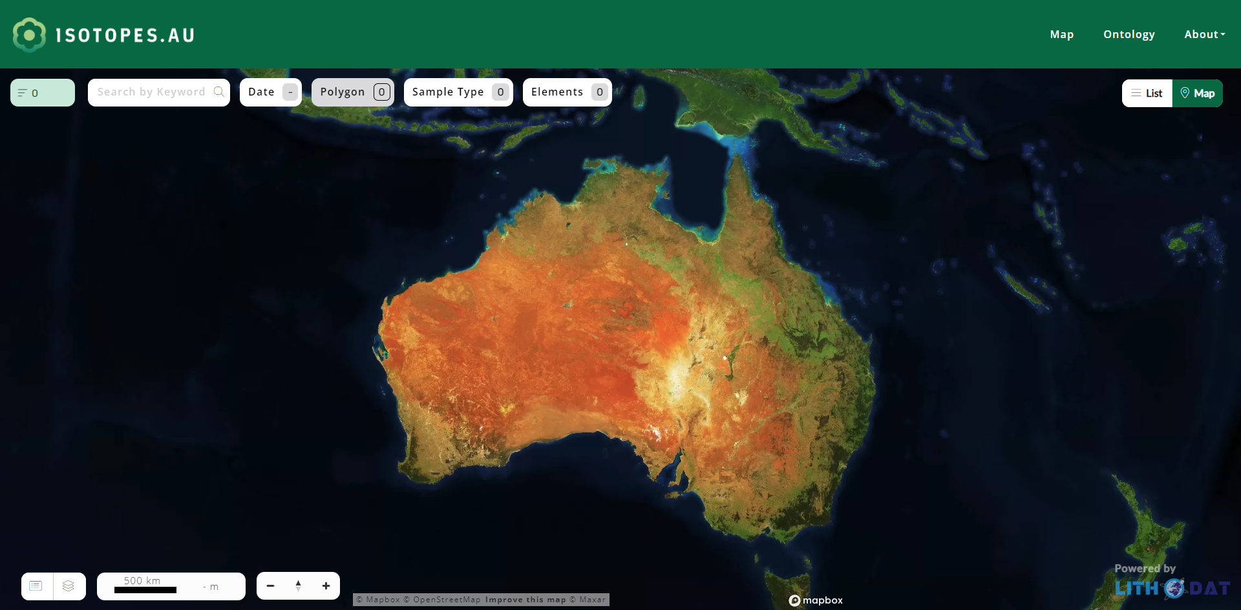
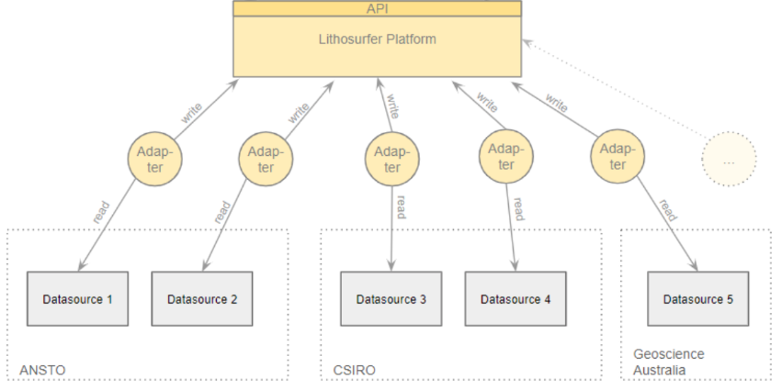
Working Model & Adapters is Basis for UI
UI
Model & Adapters
This presentation focuses on the Model & Adapter development

Slide 3
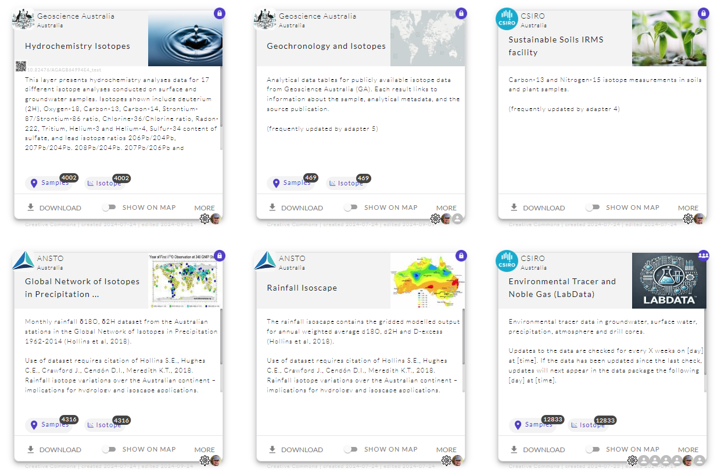
Current State of Adapters
Technically Working
This one is new since last time.
Ready for Production

Slide 4
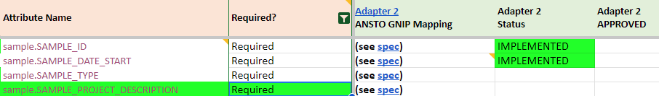
Definition of “Ready for Production”
All required fields need to have been approved by an expert.
Ontology definition sheet
Not approved yet.

Slide 5
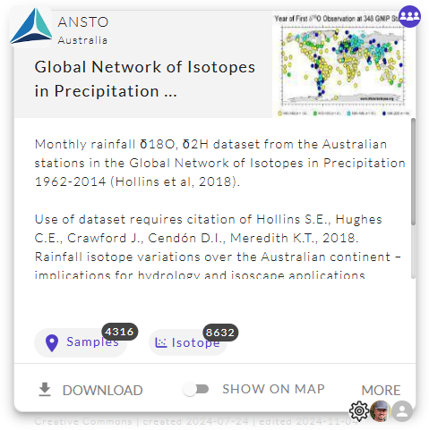

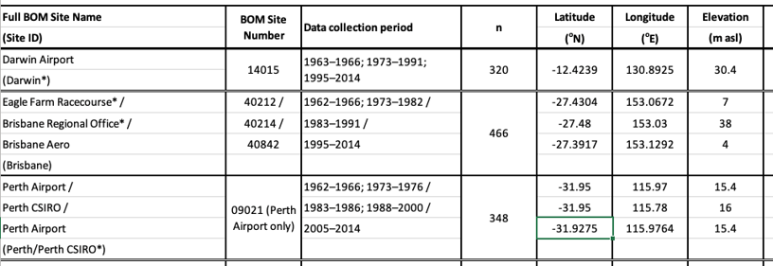
State of Adapter 2
8 of 13 Required Mappings APPROVED
Visibility: PUBLIC on TEST
Automatic Updates: no
Progress on the 13 required fields
Required Fields To Be Specified:
none
Required Fields To Be Implemented:
none
Required Fields To Be Approved:
UI_FILTER_PATH
SAMPLE_DATE_START
Publication
Measurements:
δ2H-H2O (VSMOW)
Experts: Cath + Jagoda
link

Slide 6
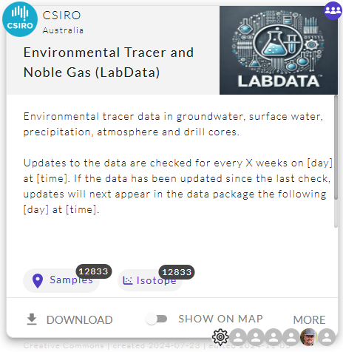
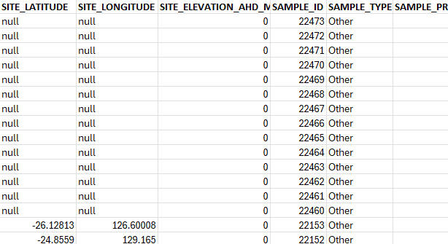
State of Adapter 3
9 of 18 Required Mappings APPROVED
Visibility: PUBLIC on TEST
Automatic Updates: yes
Progress on the 18 required fields
Required Fields To Be Specified:
SAMPLE_PROJECT_DESCRIPTION
SITE_ELEVATION_AHD_M (consider different cases)
Required Fields To Be Implemented:
none
Required Fields To Be Approved:
UI_FILTER_PATH
SAMPLE_DATE_START
SAMPLE_TYPE
Measurements:
δ13C-DIC (PDB)
87Sr/86Sr-Bulk
Other
Filter out records without location
Experts:
Christoph + Axel
Additional Measurements like Humidity and Precipitation
Ignoring Data with Exposures lacking lat+lon.

Slide 7
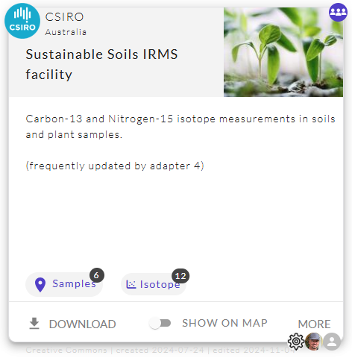
State of Adapter 4
3 of 12 Required Mappings APPROVED
Visibility: PUBLIC on TEST
Automatic Updates: no (will be coming from DAP)
Progress on the 12 required fields
Required Fields To Be Specified:
SAMPLE_PROJECT_DESCRIPTION (to come from DAP)
SAMPLE_PROJECT_IDENTIFIER (to come from DAP)
PUBLICATION (to come from DAP)
Required Fields To Be Implemented:
none
Required Fields To Be Approved:
UI_FILTER_PATH
SAMPLE_ID
SAMPLE_DATE_START
SITE_ELEVATION_AHD_M
Measurements:
δ18O-H2O (VSMOW)
δ2H-H2O (VSMOW)
Other
provisioning via DAP pending
Experts:
Nina + Steve

Slide 8
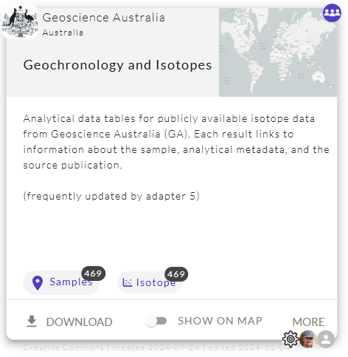
State of Adapter 5
5 of 11 Required Mappings APPROVED
Visibility: PUBLIC on TEST
Automatic Updates: yes
Progress on the 11 required fields
Required Fields To Be Specified:
SAMPLE_PROJECT_DESCRIPTION
Required Fields To Be Implemented:
PUBLICATION
SITE_ELEVATION_AHD_M
Required Fields To Be Approved:
UI_FILTER_PATH
SAMPLE_DATE_START
SAMPLE_TYPE
Experts:
Steph + Geoff

Slide 9
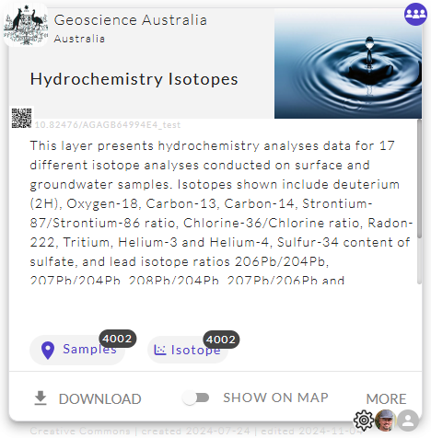
State of Adapter 6
10 of 16 Required Mappings APPROVED
Visibility: PUBLIC on TEST
Automatic Updates: yes
Progress on the 16 required fields
Required Fields To Be Specified:
SAMPLE_PROJECT_DESCRIPTION (not available)
SITE_ELEVATION_AHD_M (coming from service)
Required Fields To Be Implemented:
SAMPLE_DATE_START (see sampling date in feedback)
none
Required Fields To Be Approved:
UI_FILTER_PATH
SAMPLE_TYPE
Measurements:
δ13C-DIC (PDB)
Other
Ignore records with no measurements
Experts:
Steph + Geoff

Slide 10
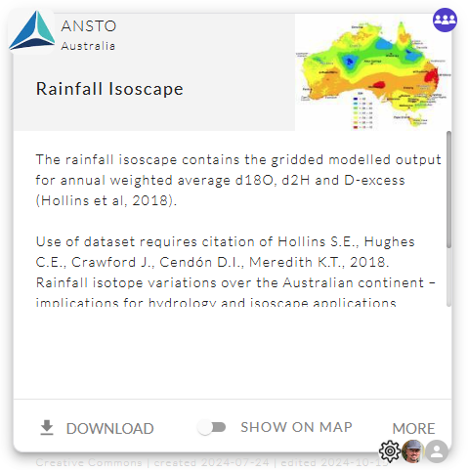
State of Adapter 1
Implementation: not started yet
Plan: Implementation after other packages are production ready.
Question: Is the provided data still up-to-date?

Slide 11
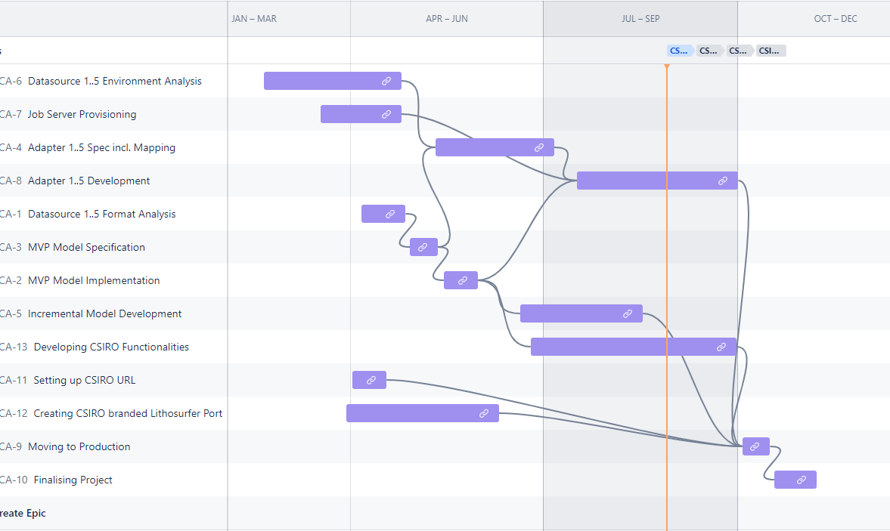
Lithodat internal Timeline
Focus on SHOW STOPPER. We will upload data to production on Tuesday, 19. Nov.
Round 1
Round 2
Round 3
Round 4

Slide 12



Next Step: Round 4
isotopes.au ontology
compares
Lithodat
Lithodat ending round 3 by creating and running new version of adapters.
(till Monday 11th with version 0.4.4)
Expert
isotope.au experts starting round 4 by comparing source with export files (v0.4.4).

Slide 13
Process of Approving the Adapters
We are entering Round 4 on Monday coming week. Probably the last Round before going productive.
To approve a field mapping the proprietary input data has to be checked against the output data in common ontology format.
How to check the mappings:
Download the latest ontology.xls of your adapter.
Pick a random row from your proprietary.xls
Find the corresponding row in the ontology.xls.
Check the mappings.
Repeat with other row if unsure.
Update ontology definition sheet
Ansto.ontology.xls
Ansto.proprietary.xls

Slide 14
Thanks!

Slide 15
Enable filtering by type on the UI

Slide 16
How to Approve
To approve a field mapping the proprietary input data has to be checked against the output data in common ontology format.

Slide 17
How to Approve
To approve a field mapping the proprietary input data has to be checked against the output data in common ontology format.
The proprietary input data gets translated (aka. mapped).
Ansto.proprietary.xls

Slide 18
How to Approve
To approve a field mapping the proprietary input data has to be checked against the output data in common ontology format.
CLICK on DOWNLOAD
Ansto.ontology.xls
The data get’s exported in the format of the common ontology.
Ansto.proprietary.xls

Slide 19

How to Approve
To approve a field mapping the proprietary input data has to be checked against the output data in common ontology format.
But how can the data be checked?
Ansto.ontology.xls
Ansto.proprietary.xls

Slide 20
Definition of “Ready for Production”
All required fields need to have been approved by an expert.
by Cath
by Cath
Ontology definition sheet
Leave a comment instead of your name in case the mapping is not as expected.

Slide 21
Full Cycle
To approve a field mapping the proprietary input data has to be checked against the output data in common ontology format.
The data get’s exported in the format of the common ontology.
CLICK on DOWNLOAD
Ansto.ontology.xls
The proprietary input data gets translated (aka. mapped).
Ansto.proprietary.xls

Slide 22
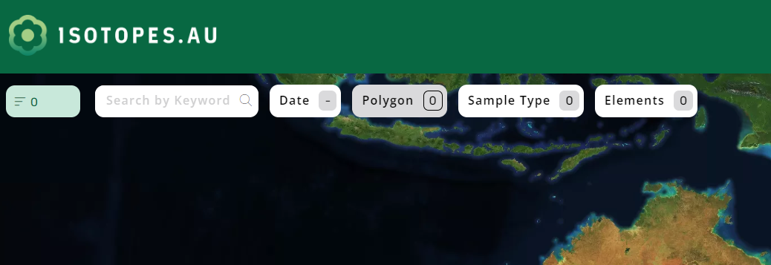
Overview of filters
!

Slide 23
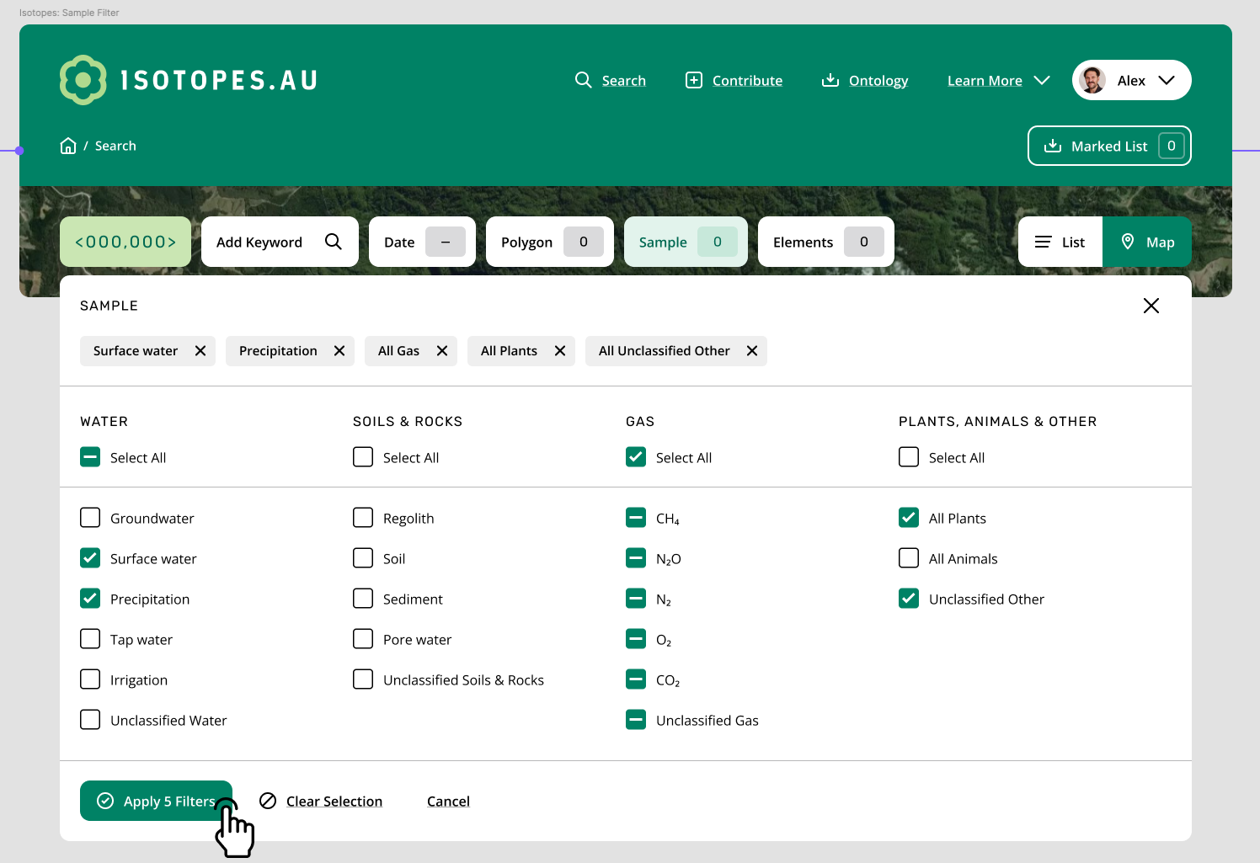
UI as specified by CSIRO (2024-09-16)
See concept

Slide 24
Main Goal of Today’s Meeting:
Understanding the Adapter Development Process
The adapters need to implement a lot of expert knowledge. Next slides will show with a concrete example how the knowledge can be transferred from the experts to the developers.

Slide 25

Overview
isotopes.au ontology
Speci- fication

Slide 26
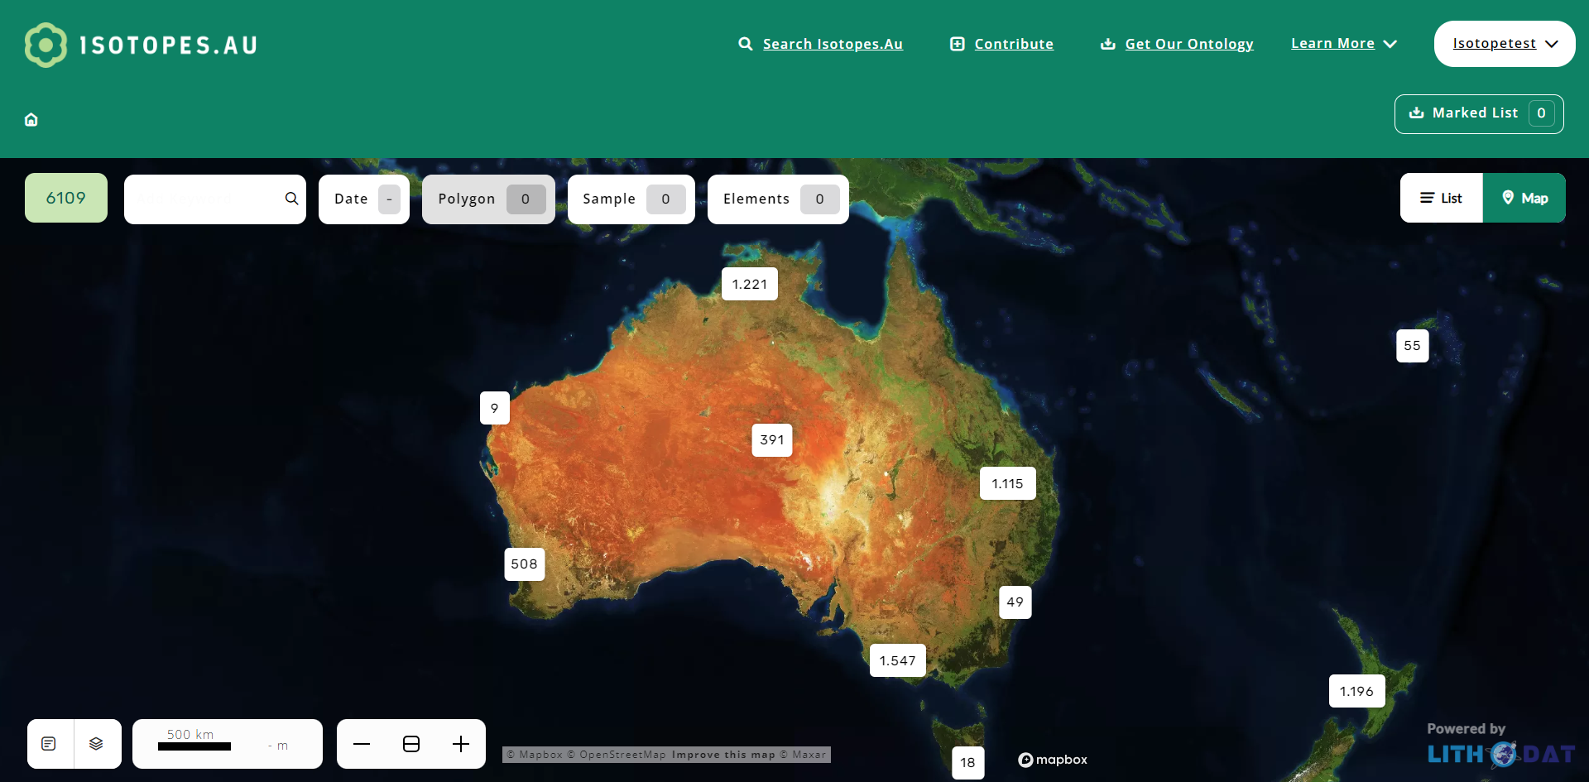
Speci- fication

Slide 27
Overview
Speci- fication
Technicals
Mappings

Slide 28
Overview
reads
Speci- fication
Coder
implements
Coder releases version when finished.

Slide 29
isotopes.au ontology
updates
compares
Speci- fication
Expert

Slide 30


isotopes.au ontology
updates
compares
Speci- fication
Expert
reports issue
Lian F.
Bug-
tracker

Slide 31
Overview
reads
Speci- fication
Coder
implements
reads
Bug-
tracker

Slide 32
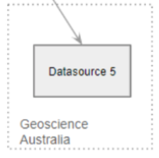
Let’s Exercise an Expert Feedback Round
What the expert needs:
Expert
isotopes.au ontology
output
Speci- fication

Slide 33
Let’s Exercise an Expert Feedback Round
How to update the spec:
feedback
Lian
edits
Expert
comments
isotopes.au ontology
output
Speci- fication

Slide 34
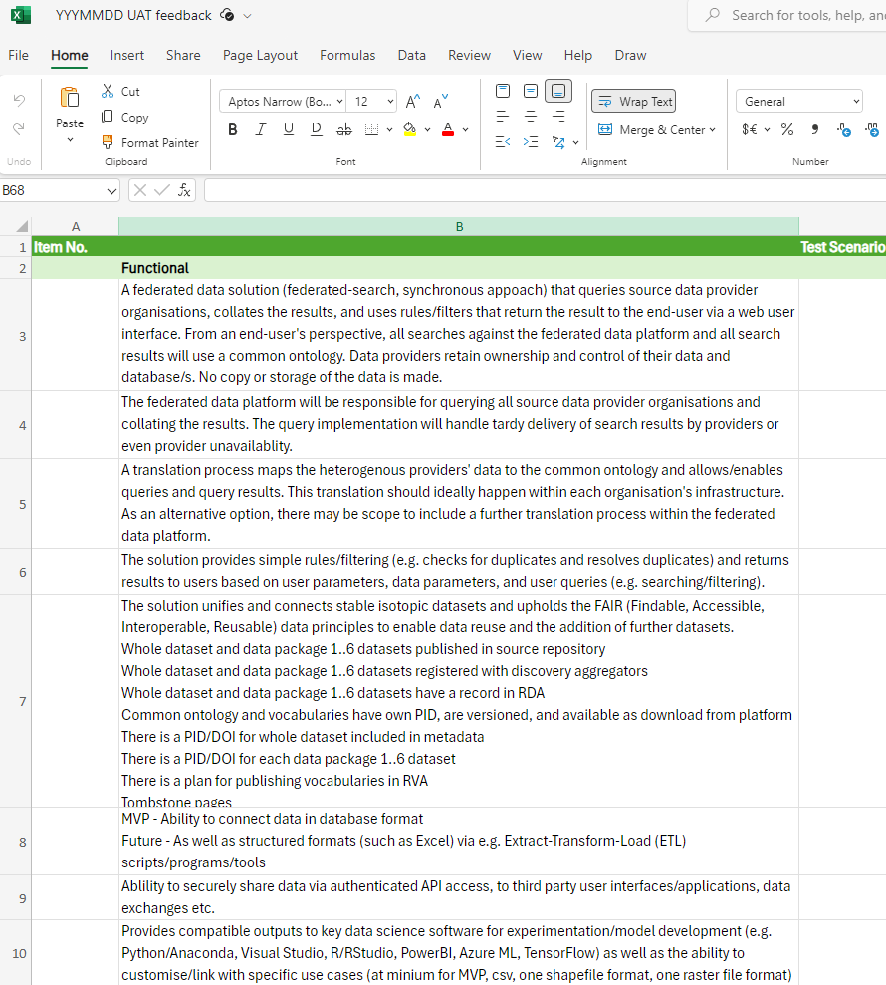
Feedback Formular

Slide 35
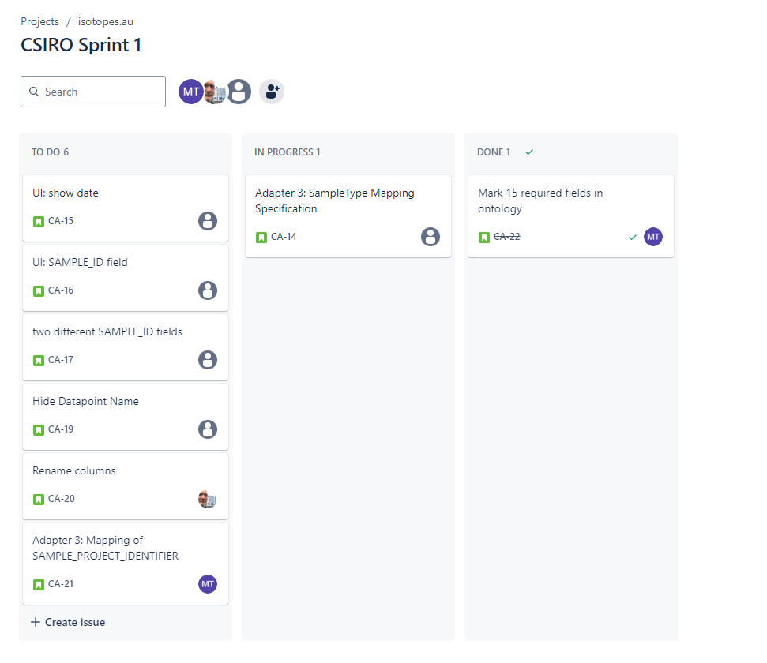
All Feedback and Issues can be managed in Jira

Slide 36
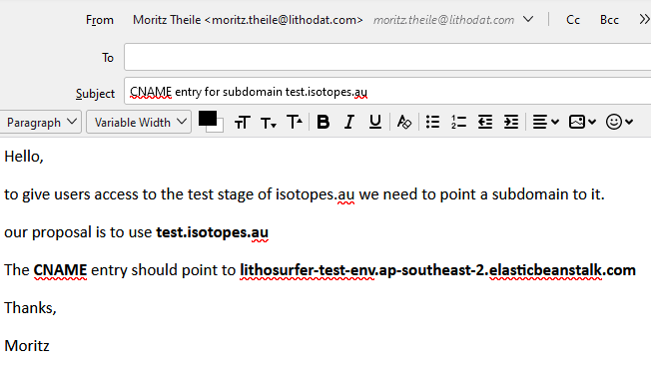
Send Mails with instructions
Who are the recipients?

